Slide 1
PrEP, prevent, test: Increasing young key populations’ uptake of HIV prevention and testing services: Leaving no one behind Young key populations in the HIV response
Rachel Baggaley, Annette Verster, Virginia Macdonald, Bradley Mathers, Shona Dalal, Heather-Marie Schmidt
@WHO
Share your thoughts on this presentation with #IAS2019

Slide 2
Why focus on young key populations
Young KP may have higher HIV risk because of:
Biology
Adolescent brain development
Greater risk taking
? Microbiome factors
Behaviour
Risk taking, overplapping vulnerabilities
Poverty & transactional sex
Poor health seeking behaviour
Social Norms
Gender inequality & violence
Young KP have difficulty negotiating sex or condom use when economically dependent on partner &/or fear violence
Stigma & discrimination: Prevents those most vulnerable to HIV from accessing HIV testing & services
Structural Barriers
Ethical and/or legal barriers (inc to accessing services)
Limited availability of youth and KP friendly services
Prejudicial health worker attitudes and lack of specialized KP knowledge and training
“When (they) understood our identity as sex workers (they) completely refused to provide health services; most of the time doctors ignored us.”
Young sex worker, Bangladesh

Slide 3
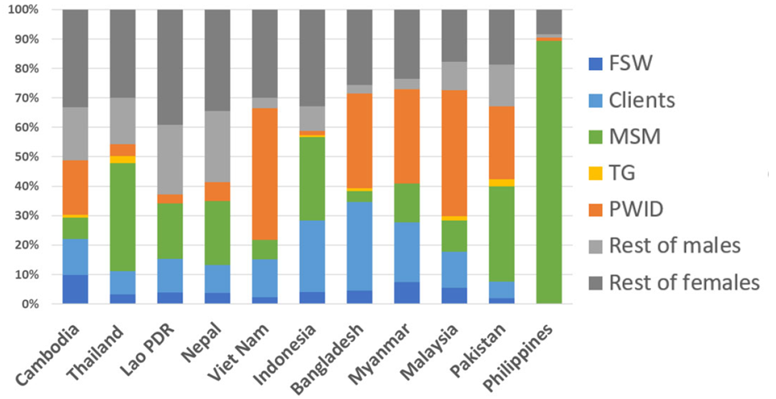
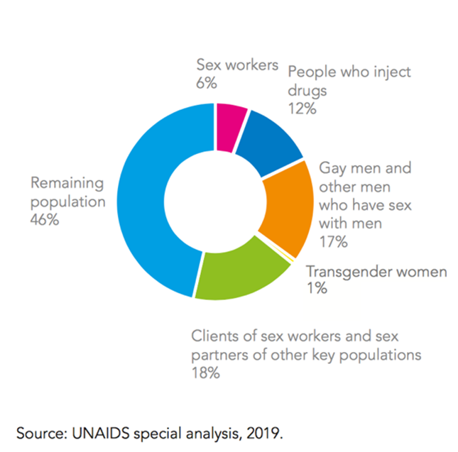
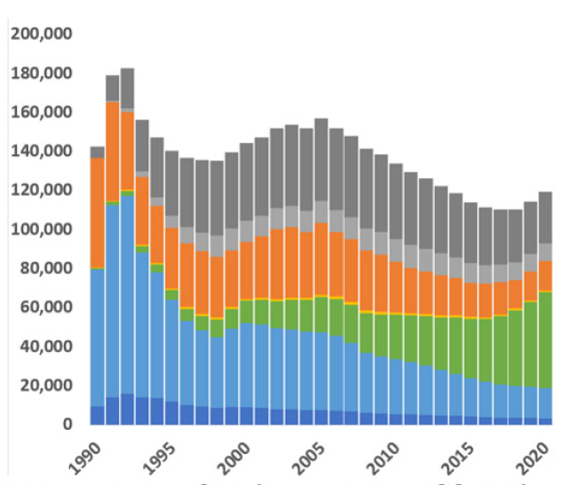
Time for much greater KP focus
# new HIV infections by subpopulation
2019 Majority of new HIV infections are among key populations and their sex partners…with variability across regions
New infections by subpopulation 1990-2020 aggregated across 11 Asian countries
Source:Tim Brown and Wiwat Peerapatanapokin, Current Opinions, July 2019

Slide 4
Time for much greater young KP focus
Proportion of key populations who are young people (aged 15-24)
East Asia and the Pacific | Eastern Europe and Central Asia | South Asia | Middle East and North Africa | Eastern and Southern Africa | West and Central Africa | Latin America and the Caribbean
 |  |  | ← Young people aged 15-24
MSM | PWID | FSW | ← People aged 25-49
Source: Annette Verster (ongoing analysis WHO and UNICEF, 2019)

Slide 5
Steep increases in the proportion of young people with HIV occurring in some Asia-Pacific countries
HIV prevalence among young MSM
(<25 years)
Indonesia
Malaysia
4X
2.5X
Proportion of young people among total estimated new HIV infections, 2018
Prepared by www.aidsdatahub.org based on Global AIDS Monitoring 2018
Notes:
Steep increases in the proportion of young people living with HIV have been observed in some countries, including malaysia, the PHilippines, Indonesia, China and Thailand.

Slide 6
Pakistan 2016-17 IBBS – HIV prevalence
National Surveillance Round – data from 23 cities.
People who inject drugs |  | Transgender (hijra) sex workers |  | Female sex workers*
*Average age of initiation
of sex work 22.1 years
Source: Arshad Altaf, Pakistan MoH and WHO 2019

Slide 7
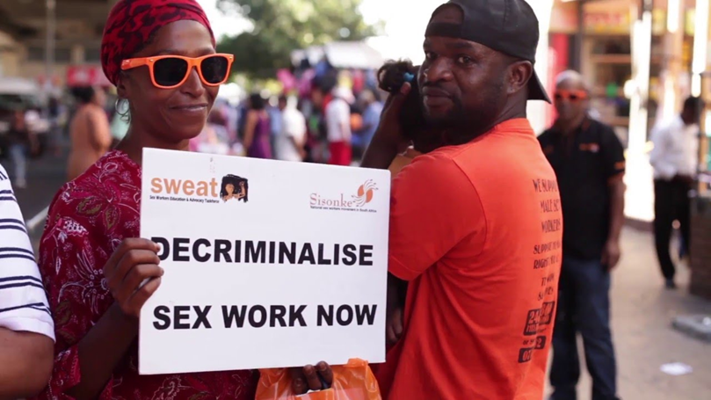
WHO Consolidated guidance for HIV prevention, diagnosis, treatment and care for key populations
Structural interventions part of a comprehensive, evidence based public health approach
Condom programming
Harm reduction interventions (NSP, OST, naloxone)
Behavioural interventions
ART related prevention: PMTCT, PrEP, PEP
HIV testing services and treatment and care
Prevention and management of viral hepatitis, TB and mental health conditions
Sexual and reproductive health interventions
Supportive legislation, policy and funding
Addressing stigma and discrimination
Community empowerment
Addressing violence
Health interventions
Key considerations for young KP
Structural
interventions
WHO consolidate KP guidelines 2014, updated 2016

Slide 8
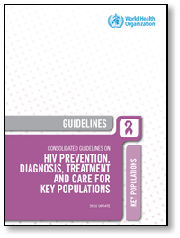
What’s new 1.New approaches to HIV testing – HIV self-testing, partner notification and social network testing
2.Multiple effective prevention interventions – incuding PrEP
3.Better and simplified treatment with differentiated service delivery options
HIV testing\inc HIVST
New media
Behaviour-education
Structural-legal
stigma
ART
Combination prevention
Inc PrEP
Think STIs
Think TB
Think FP
Don’t forget hepatitis

Slide 9
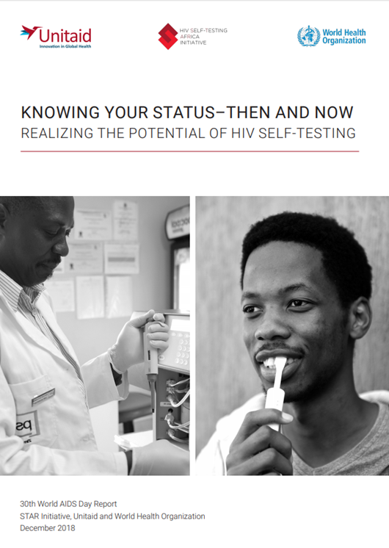
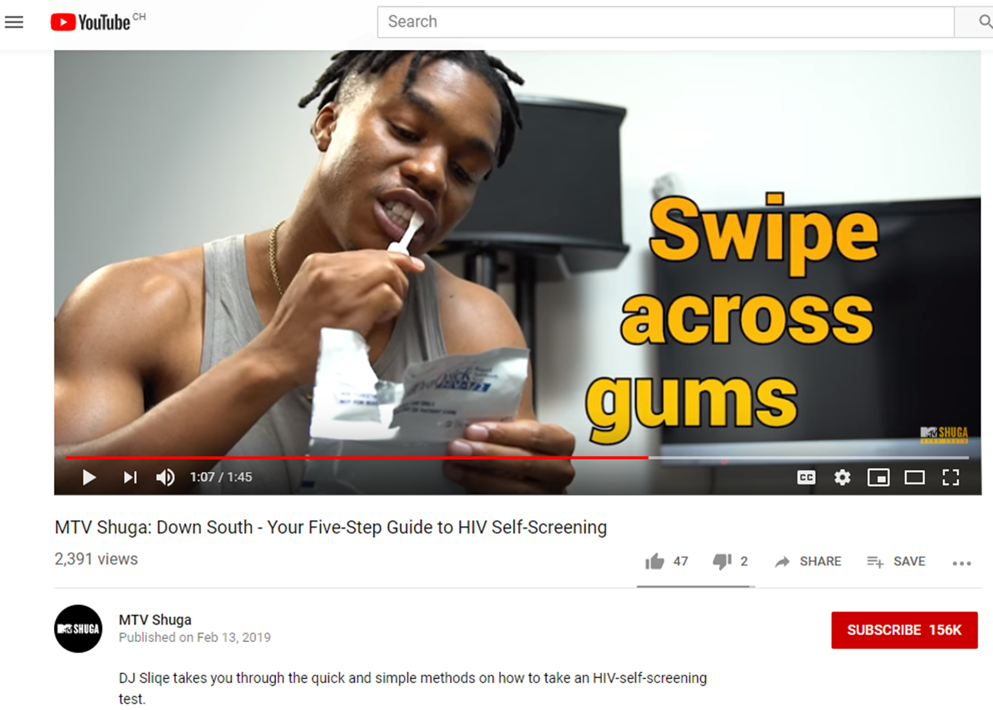
1. HIV self-testing
Young people perform HIVST better than older people
HIVST is highly acceptable among YP & YKP
HIVST can be empowering
% self-testing in Malawi, Zambia & Zimbabwe, community-based HIVST (total # >400k)
Source: STAR (Unitaid, PSI, LHHTM, LSTM, WHO)

Slide 10
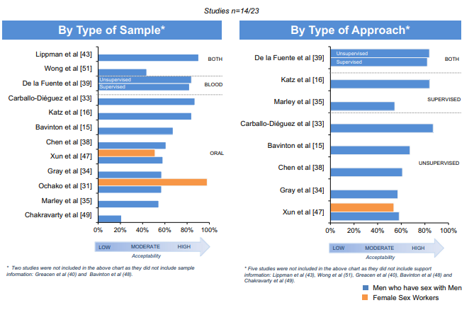
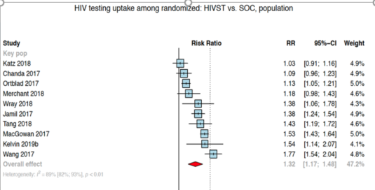
High HIVST acceptability by KP
High HIVST uptake by KP
Source: Figueroa 2015 AIDS Behav
Source: WHO systematic review July 2019

Slide 11
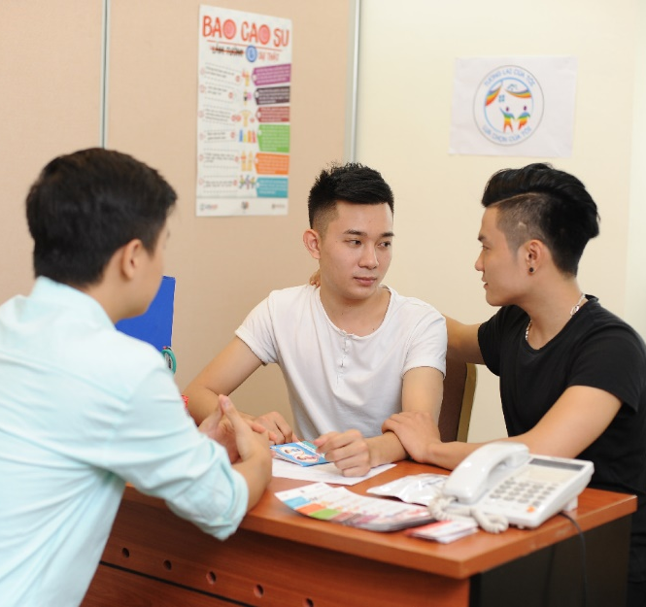
2. Partner testing “Love and respect - a powerful tool to overcome barriers to partner disclosure of HIV status”
Partner services for adolescent KP need to be provided with sensitivity
Receiving information about HIV status may more emotionally challenging for young people
Adolescents especially vulnerable to IPV
Age of consent for HIV testing can be a barrier
Providers need to speak sensitively about sex and sexual partners with young KP
“I know there are many barriers, but you will find peace of mind once you have successfully informed your partner about your HIV status. I would have felt guilty and not been able to work or study if I hadn’t told my partner. We have some responsibility for them.”
– Index client, Ho Chi Minh City
Source: Dr. Van Thi Thuy Nguyen, WHO
Dr. Bao Ngoc Vu, PATH
PNS counseling in action
Photo: USAID/PATH Healthy Markets

Slide 12
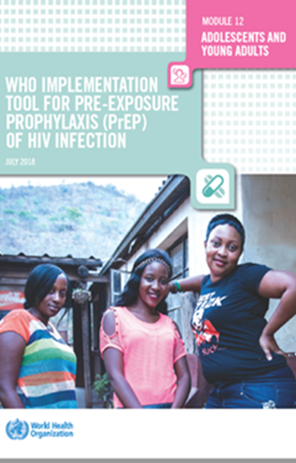
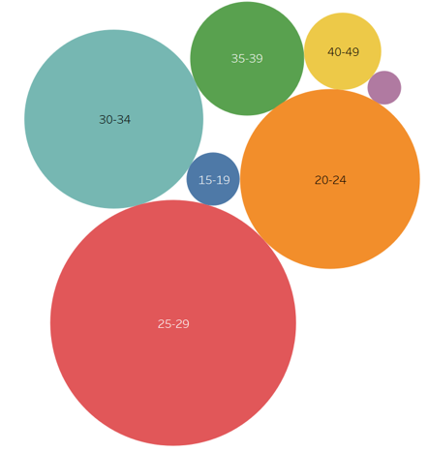
3. PrEP
WHO recommends offer of PrEP to people at substantial HIV risk
Special considerations for adolescents and young people
50+
PrEP uptake by KP group
15-19
84.1%
12.4%
PrEP uptake by age
3.5%
Source: Dr Kim Green, Dr. Bao Ngoc Vu, PATHDr. Van Thi Thuy Nguyen, WHO
Viet Nam: Most PrEP users are young MSM

Slide 13
Continuation on PrEP, Thailand (n=1,697)
Young KP may need more support for PrEP adherence and continuation
Source: Dr.Nittaya Phanuphak Pungpapong, Thai Red Cross

Slide 14
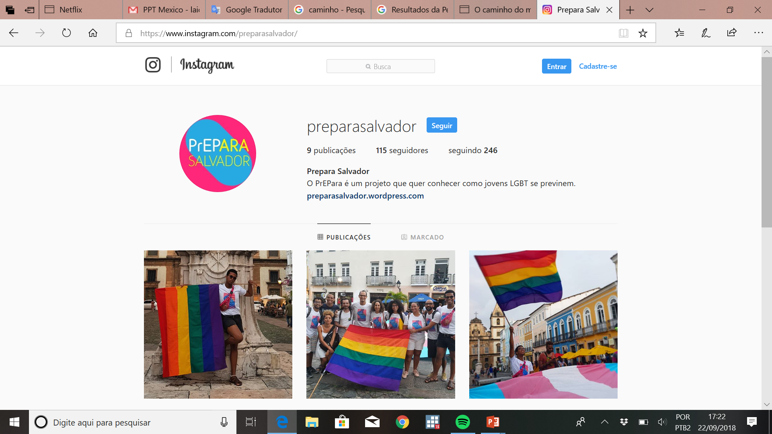
4. Using new media
Creating PrEP demand,
Brazil
Social networks
Postcards

Slide 15
5. Go with the youth energy, passion, ideas and reach
Tuk Tuk Race for Pride Week in May 2019, Phnom Penh, Cambodia
Source: Dr.Heather-Maria Schmit WHO&UNAIDS, Thailand
Photo credit: Kyoungmi Kim/ UNAIDS Cambodia.

Slide 16
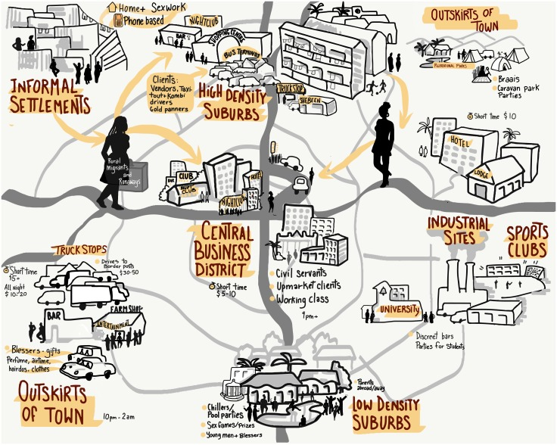
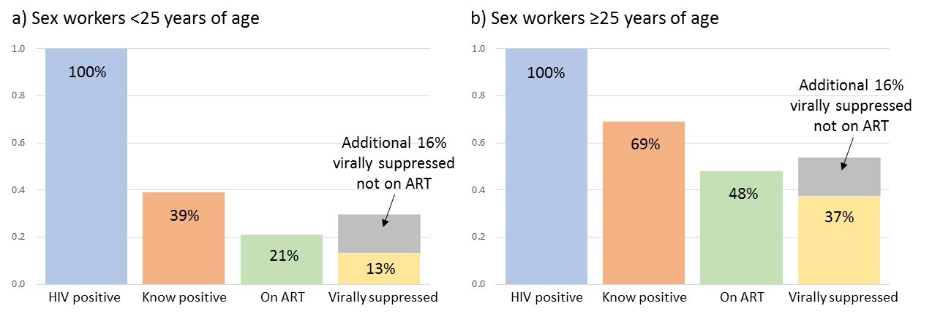
Services for young women who sell sex Sisters with a voice: Zimbabwe
Young women selling sex may not self-identify as sex workers.
Younger trained peer educators undertake outreach and referral.
Young Sisters Programme (15-24), younger peer educators (18-24)
DSD for young women - age-specific demand creation, community outreach and adherence support.
Efforts to secure financial assistance (e.g. from Dept Social Welfare or through special grants) to subsidize school fees, family cash transfers and other benefits
‘
‘They (sex workers) are very different from me, you can tell them by how they walk, talk and dress - and that is not me.’
17-year old newcomer to Sisters clinic
Source: Napierala et al Engagement in HIV Care Among Young FSW in Zimbabwe JAIDS, 2018

Slide 17
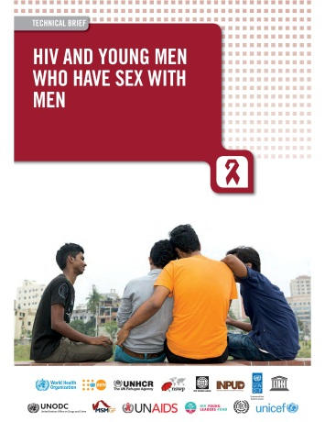
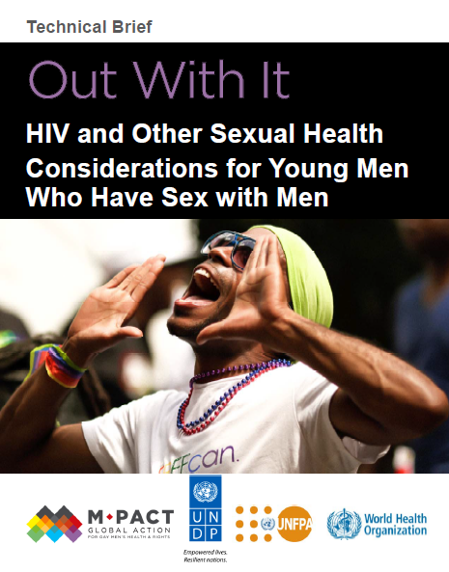
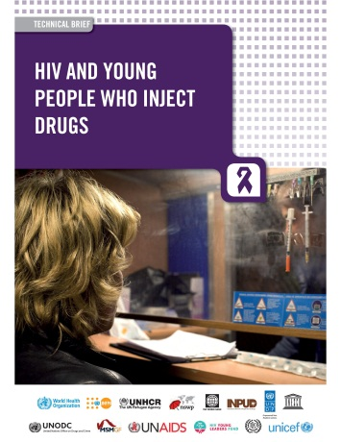
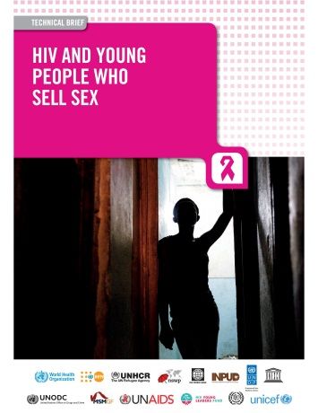
Available resource to support young KP programming
WHO HIV Dept. Innovative Prevention Unit

Slide 18
Coming soon
Support countries to scale-up HIV prevention interventions for ayKPs and migrants
A resource to be used when providing TA in countries
Online compendium of tools and guidance
Organized and annotated
Global in scope, locally relevant
Highlighting good practices
Broader than interventions and service delivery
Particular focus on digital platforms and online approaches
Participants include..
AMSHeR
AWOSHe
SOMOSGAY
GayLatino
Teenergizer
Youth LEAD
Youth Voices Count
Youth RISE
IAS Youth Champions
INPUD
ITRG
Mpact
NSWP
http://childrenandaids.org/aykpToolkit/about

Slide 19
In summary: Considerations for programmes and service delivery for young KP
Build on strengths and capacities of YP
Involve YP in planning, design, implementation, M&E
Use existing infrastructure & services demonstrated to be appropriate e & effective for YP
Integrated Health, welfare, protection, education & social protection services
M&E to consider YP with appropriate age disaggregation
Build capacity of health and social workers to provide services for YP

Slide 20
“I went for general health check-up. At first everything was fine. ..then the doctor realized and started smiling, making inappropriate jokes about [being] gay .”
Young MSM, Albania
We know HIV disproportionally affect KP & young KP are particularly vulnerable – impact on HIV impossible without increasing access to and uptake & coverage of effective and acceptable services for KP including YKP
We know what to do
There are many examples of good KP programming.. But not at scale
Health sector and youth and community partnerships essential
Even in legally constrained settings public health and medical ethics require proving respectful quality HIV services for YKP
“When they go to the doctor, first of all the doctor will give a smile ... then they will make sarcastic remarks, ask strange questions and make them feel embarrassed.”
Young transgender person, Pakistan

